Slide 1


Principles of Information Security,
Fifth Edition
Chapter 8
Cryptography

Slide 2
Learning Objectives
Upon completion of this material, you should be able to:
  Chronicle the most significant events and discoveries in the history of cryptology
  Explain the basic principles of cryptography
  Describe the operating principles of the most popular cryptographic tools
  List and explicate the major protocols used for secure communications
Principles of Information Security, Fifth Edition
Notes:
Learning Objectives
Upon completion of this material, you should be able to:
Chronicle the most significant events and discoveries in the history of cryptology
Explain the basic principles of cryptography
Describe the operating principles of the most popular cryptographic tools
List and explicate the major protocols used for secure communications

Slide 3
Introduction
Cryptology: science of encryption; encompasses cryptography and cryptanalysis
Cryptography involves making and using codes to secure messages.
Cryptanalysis involves cracking or breaking encrypted messages back into their unencrypted origins.
Principles of Information Security, Fifth Edition
Notes:
Introduction
Cryptology: science of encryption; encompasses cryptography and cryptanalysis
Cryptography involves making and using codes to secure messages
Cryptanalysis involves cracking or breaking encrypted messages back into their unencrypted origins

Slide 4
Foundations of Cryptology
Cryptology has an extensive and multicultural history.
All popular Web browsers use built-in encryption features for secure e-commerce applications.
Restrictions on the export of cryptosystems began after WWII.
Principles of Information Security, Fifth Edition
Notes:
Foundations of Cryptology
Cryptology has an extensive and multicultural history
All popular Web browsers use built-in encryption features for secure e-commerce applications
Restrictions on the export of cryptosystems began after WWII

Slide 5
Terminology
  Encrypt
  Key/Cryptovariable
  Keyspace
  Link encryption
  Plaintext/cleartext
  Steganography
  Work factor
Must know the following:
  Algorithm
  Bit stream cipher
  Block cipher
  Cipher or cryptosystem
  Ciphertext/cryptogram
  Code
  Decipher
  Decrypt
  Encipher
Principles of Information Security, Fifth Edition
Notes:
Foundations of Cryptology
Cryptology has an extensive and multicultural history
All popular Web browsers use built-in encryption features for secure e-commerce applications
Restrictions on the export of cryptosystems began after WWII

Slide 6
Cipher Methods
Plaintext can be encrypted through bit stream or block cipher method.
Bit stream: Each plaintext bit is transformed into cipher bit one bit at a time.
Block cipher: Message is divided into blocks (e.g., sets of 8- or 16-bit blocks), and each is transformed into encrypted block of cipher bits using algorithm and key.
Principles of Information Security, Fifth Edition
Notes:
Cipher Methods
Plaintext can be encrypted through bit stream or block cipher method
Bit stream: each plaintext bit transformed into cipher bit one bit at a time
Block cipher: message divided into blocks (e.g., sets of 8- or 16-bit blocks) and each is transformed into encrypted block of cipher bits using algorithm and key

Slide 7
Substitution Cipher
Exchanges one value for another
Monoalphabetic substitution: uses only one alphabet during encryption process
Polyalphabetic substitution: more advanced; uses two or more alphabets
Vigenère cipher: advanced substitution cipher that uses simple polyalphabetic code; made up of 26 distinct cipher alphabets
Principles of Information Security, Fifth Edition
Notes:
Substitution Cipher
Exchanges one value for another
Monoalphabetic substitution: uses only one alphabet during encryption process
Polyalphabetic substitution: more advanced; uses two or more alphabets
Vigenère cipher: advanced substitution cipher that uses simple polyalphabetic code; made up of 26 distinct cipher alphabets

Slide 8
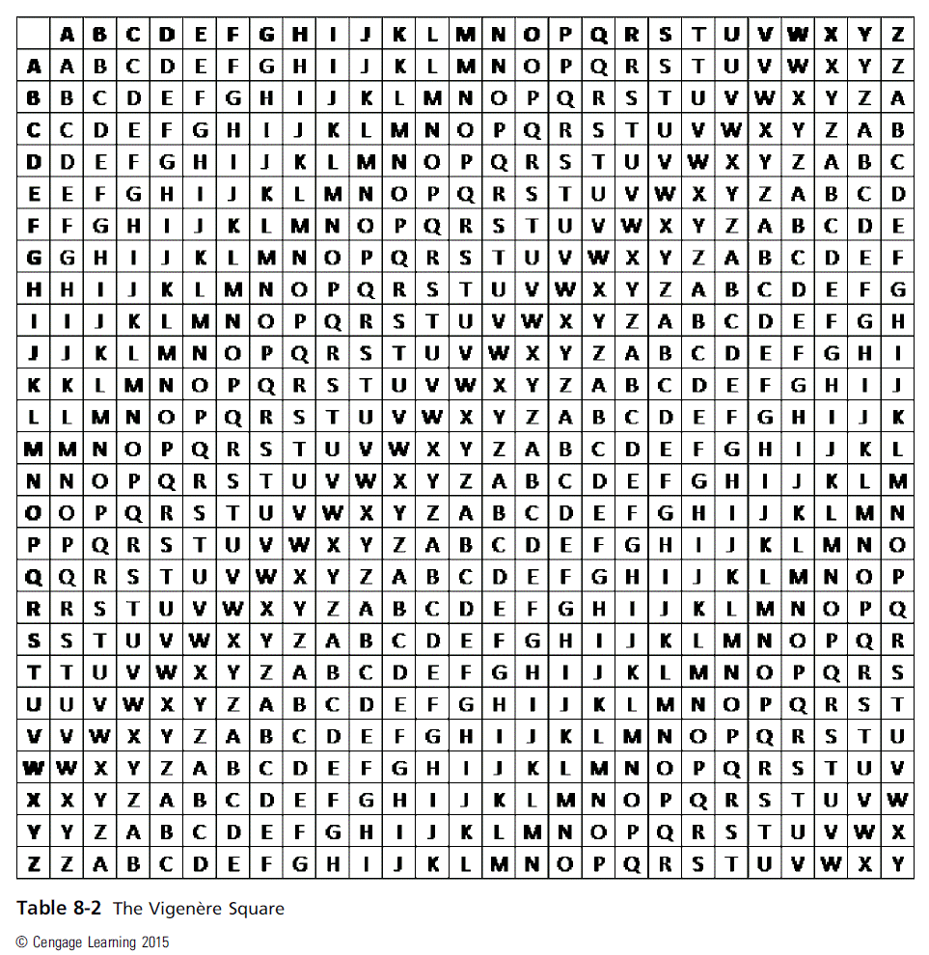
Principles of Information Security, Fifth Edition

Slide 9
Transposition Cipher
Simple to understand, but if properly used, produces ciphertext that is difficult to decipher
Rearranges values within a block to create ciphertext
Can be done at the bit level or at the byte (character) level
To make the encryption even stronger, the keys and block sizes can be increased to 128 bits or more.
  Uses block padding method to facilitate algorithm
Principles of Information Security, Fifth Edition
Notes:
Transposition Cipher Method
Simple to understand, but if properly used, produces ciphertext that is difficult to decipher
Rearranges values within a block to create ciphertext
Can be done at the bit level or at the byte (character) level
To make the encryption even stronger, the keys and block sizes can be increased to 128 bits or more
Uses block padding method to facilitate algorithm

Slide 10
Exclusive OR (XOR)
Function of Boolean algebra; two bits are compared and binary result is generated.
  If two bits are identical, the result is binary 0.
  If two bits are not identical, the result is binary 1.
Very simple to implement and simple to break; should not be used by itself when organization is transmitting/storing sensitive data
Principles of Information Security, Fifth Edition
Notes:
Exclusive OR (XOR)
Function of Boolean algebra; two bits are compared and binary result generated
If two bits are identical, result is binary 0
If two bits not identical, result is binary 1
Very simple to implement and simple to break; should not be used by itself when organization is transmitting/storing sensitive data

Slide 11
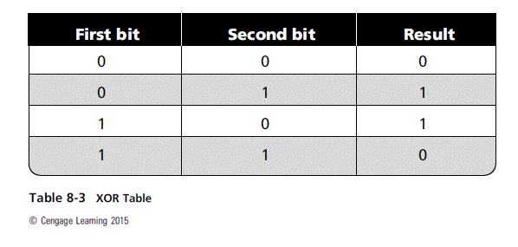
Principles of Information Security, Fifth Edition

Slide 12
Vernam Cipher
Developed at AT&T Bell Labs
Uses a set of characters once per encryption process
To perform:
  The pad values are added to numeric values that represent the plaintext that needs to be encrypted.
  Each character of the plaintext is turned into a number and a pad value for that position is added.
  The resulting sum for that character is then converted back to a ciphertext letter for transmission.
  If the sum of the two values exceeds 26, then 26 is subtracted from the total.
Principles of Information Security, Fifth Edition
Notes:
Vernam Cipher
Developed at AT&T Bell Labs
Uses set of characters once per encryption process
To perform:
The pad values are added to numeric values that represent the plaintext that needs to be encrypted
Each character of the plaintext is turned into a number and a pad value for that position is added
The resulting sum for that character is then converted back to a ciphertext letter for transmission
If the sum of the two values exceeds 26, then 26 is subtracted from the total

Slide 13
Book-Based Ciphers
Uses text in book as key to decrypt a message
Book cipher: ciphertext consists of list of codes representing page, line, and word numbers of plaintext word.
Running key cipher: uses a book for passing key to cipher similar to Vigenère cipher; sender provides encrypted message with sequence of numbers from predetermined book to be used as an indicator block.
Template Cipher: involves use of hidden message in book, letter, or other message; requires page with specific number of holes cut into it
Principles of Information Security, Fifth Edition
Notes:
Book-Based Ciphers
Uses text in book as key to decrypt a message
Book cipher: ciphertext consists of list of codes representing page, line, and word numbers of plaintext word
Running key cipher: uses a book for passing key to cipher similar to Vigenère cipher; sender provides encrypted message with sequence of numbers from predetermined book to be indicator block
Template Cipher: involves use of hidden message in book, letter, or other message; requires page with specific number of holes cut into it.

Slide 14
Hash Functions
Mathematical algorithms used to confirm specific message identity and that no content has changed
Hash algorithms: public functions that create hash value
Use of keys not required
  Message authentication code (MAC), however, may be attached to a message.
Used in password verification systems to confirm the identity of the user
Principles of Information Security, Fifth Edition
Notes:
Hash Functions
Mathematical algorithms used to confirm specific message identity and that no content has changed
Hash algorithms: public functions that create hash value
Use of keys not required
Message authentication code (MAC), however, may be attached to a message
Used in password verification systems to confirm identity of user

Slide 15
Cryptographic Algorithms
Often grouped into two broad categories, symmetric and asymmetric
  Today’s popular cryptosystems use a combination of both symmetric and asymmetric algorithms.
Symmetric and asymmetric algorithms are distinguished by the types of keys used for encryption and decryption operations.
Principles of Information Security, Fifth Edition
Notes:
Cryptographic Algorithms
Often grouped into two broad categories, symmetric and asymmetric
Today’s popular cryptosystems use combination of both symmetric and asymmetric algorithms
Symmetric and asymmetric algorithms distinguished by types of keys used for encryption and decryption operations

Slide 16
Symmetric Encryption
Requires same “secret key” to encipher and decipher message; also known as private-key encryption
  Can be programmed into fast computing algorithms and executed quickly
  Both sender and receiver must possess secret key.
  If either copy of key is compromised, an intermediate can decrypt and read messages without sender/receiver knowledge.
Principles of Information Security, Fifth Edition
Notes:
Symmetric Encryption
Symmetric encryption indicates that the same key, also known as a secret key, is used to conduct both the encryption and decryption of the message.
Symmetric encryption methods can be extremely efficient, requiring minimal processing to either encrypt or decrypt the message.
The problem is that both the sender and the receiver must own the encryption key.
If either copy of the key is compromised, an intermediate can decrypt and read the messages.
One of the challenges of symmetric key encryption is getting a copy of the key to the receiver, a process that must be conducted out-of-band to avoid interception.

Slide 17
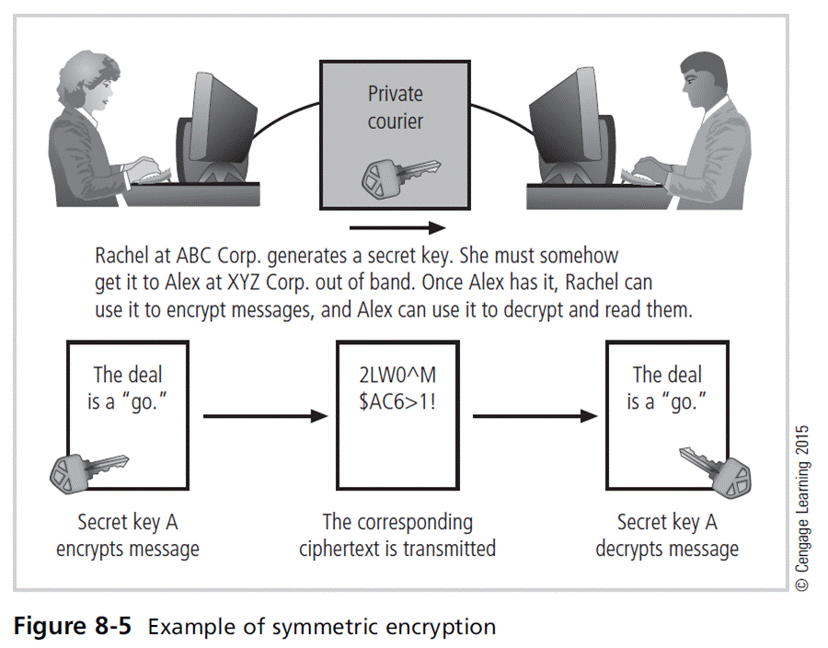
Principles of Information Security, Fifth Edition

Slide 18
Symmetric Encryption (cont’d)
Data Encryption Standard (DES): one of the most popular symmetric encryption cryptosystems
  64-bit block size; 56-bit key
  Adopted by NIST in 1976 as federal standard for encrypting non-classified information
Triple DES (3DES): created to provide security far beyond DES
Advanced Encryption Standard (AES): developed to replace both DES and 3DES
Principles of Information Security, Fifth Edition
Notes:
Symmetric Encryption
Data Encryption Standard (DES): one of most popular symmetric encryption cryptosystems
64-bit block size; 56-bit key
Adopted by NIST in 1976 as federal standard for encrypting non-classified information
Triple DES (3DES): created to provide security far beyond DES
Advanced Encryption Standard (AES): developed to replace both DES and 3DES

Slide 19
Asymmetric Encryption
Also known as public-key encryption
Uses two different but related keys
  Either key can encrypt or decrypt a message
  If Key A encrypts message, only Key B can decrypt
  Greatest value when one key serves as private key and the other serves as public key
RSA algorithm was the first public-key encryption algorithm developed/published for commercial use.
Principles of Information Security, Fifth Edition
Notes:
Asymmetric Encryption
Also known as public-key encryption
Uses two different but related keys
Either key can encrypt or decrypt message
If Key A encrypts message, only Key B can decrypt
Greatest value when one key serves as private key and the other serves as public key
RSA algorithm was first public-key encryption algorithm developed/published for commercial use

Slide 20
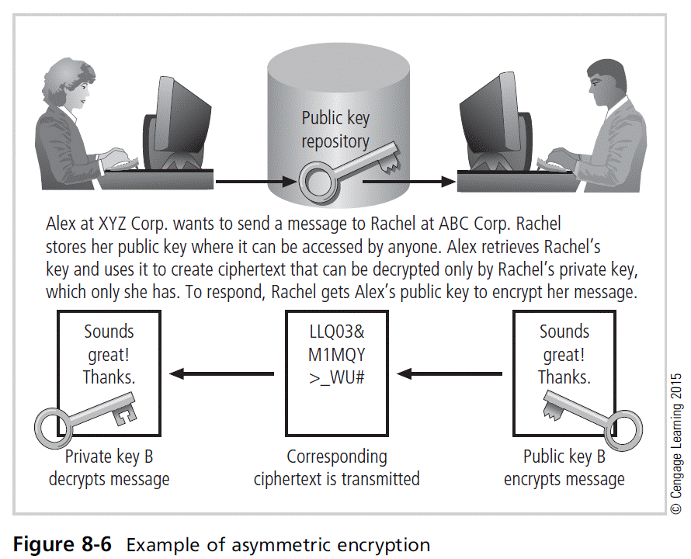
Principles of Information Security, Fifth Edition

Slide 21
Encryption Key Size
When deploying ciphers, the size of cryptovariable or key is very important.
The strength of many encryption applications and cryptosystems is measured by key size.
For cryptosystems, the security of encrypted data is not dependent on keeping the encrypting algorithm secret.
Cryptosystem security depends on keeping some or all of elements of cryptovariable(s) or key(s) secret.
Principles of Information Security, Fifth Edition
Notes:
Encryption Key Size
When deploying ciphers, size of cryptovariable or key is very important
Strength of many encryption applications and cryptosystems measured by key size
For cryptosystems, security of encrypted data is not dependent on keeping encrypting algorithm secret
Cryptosystem security depends on keeping some or all of elements of cryptovariable(s) or key(s) secret

Slide 22
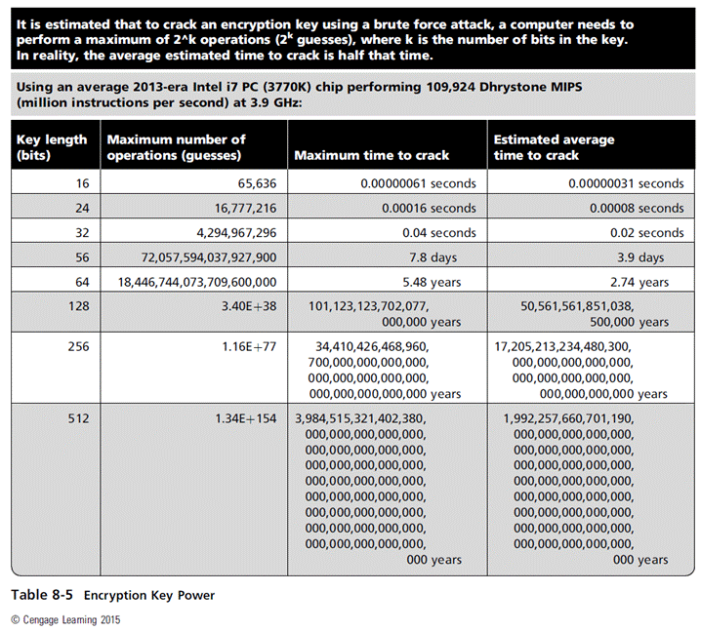
Principles of Information Security, Fifth Edition

Slide 23
Cryptographic Tools
Potential areas of use include:
  Ability to conceal the contents of sensitive messages
  Verify the contents of messages and the identities of their senders
Tools must embody cryptographic capabilities so that they can be applied to the everyday world of computing.
Principles of Information Security, Fifth Edition
Notes:
Cryptographic Tools
Potential areas of use include:
Ability to conceal the contents of sensitive messages
Verify the contents of messages and the identities of their senders
Tools must embody cryptographic capabilities so that they can be applied to the everyday world of computing

Slide 24
Public-Key Infrastructure (PKI)
Integrated system of software, encryption methodologies, protocols, legal agreements, and third-party services enabling users to communicate securely
PKI systems based on public-key cryptosystems
PKI protects information assets in several ways:
  Authentication
  Integrity
  Privacy
  Authorization
  Nonrepudiation
Principles of Information Security, Fifth Edition
Notes:
PKI
Integrated system of software, encryption methodologies, protocols, legal agreements, and third-party services enabling users to communicate securely
PKI systems based on public-key cryptosystems
PKI protects information assets in several ways:
Authentication
Integrity
Privacy
Authorization
Nonrepudiation

Slide 25
Public-Key Infrastructure (PKI) (cont’d)
Typical PKI solution protects the transmission and reception of secure information by integrating:
  A certificate authority (CA)
  A registration authority (RA)
  Certificate directories
  Management protocols
  Policies and procedures
Principles of Information Security, Fifth Edition
Notes:
PKI
Typical PKI solution protects the transmission and reception of secure information by integrating:
A certificate authority (CA)
A registration authority (RA)
Certificate directories
Management protocols
Policies and procedures

Slide 26
Digital Signatures
Created in response to rising the need to verify information transferred via electronic systems
Asymmetric encryption processes used to create digital signatures
Nonrepudiation: the process that verifies the message was sent by the sender and thus cannot be refuted
Digital Signature Standard (DSS)
Principles of Information Security, Fifth Edition
Notes:
Digital Signatures
Created in response to rising need to verify information transferred via electronic systems
Asymmetric encryption processes used to create digital signatures
Nonrepudiation: the process that verifies the message was sent by the sender and thus cannot be refuted
Digital Signature Standard (DSS)

Slide 27
Digital Certificates
Electronic document/container file containing key value and identifying information about entity that controls key
Digital signature attached to certificate’s container file certifies file’s origin and integrity
Different client-server applications use different types of digital certificates to accomplish their assigned functions.
Distinguished name (DN): uniquely identifies a certificate entity
Principles of Information Security, Fifth Edition
Notes:
Digital Certificates
Electronic document/container file containing key value and identifying information about entity that controls key
Digital signature attached to certificate’s container file certifies file’s origin and integrity
Different client-server applications use different types of digital certificates to accomplish their assigned functions
Distinguished name (DN): uniquely identifies a certificate entity

Slide 28
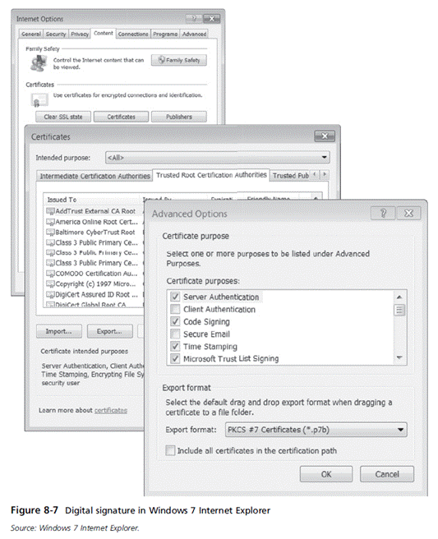
Principles of Information Security, Fifth Edition

Slide 29
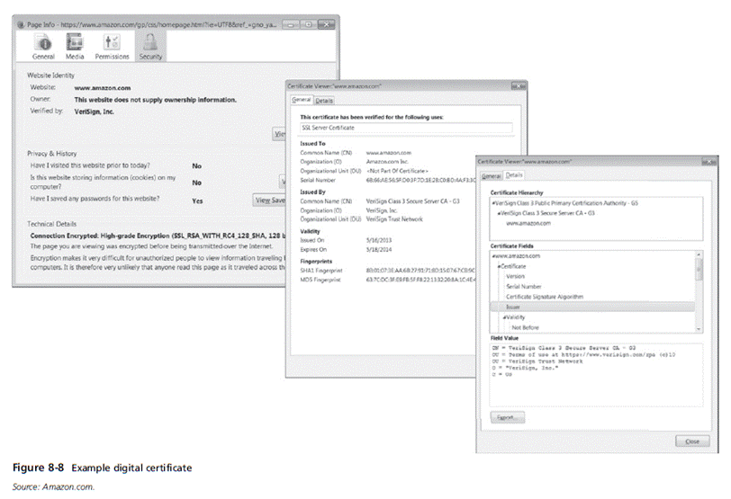
Principles of Information Security, Fifth Edition

Slide 30
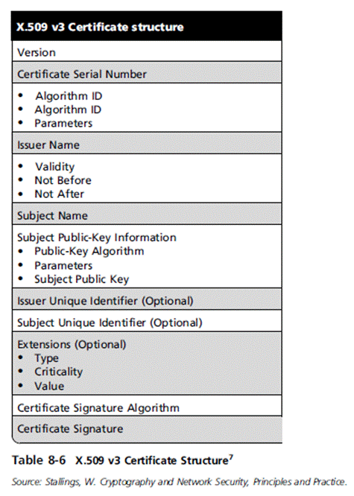
Principles of Information Security, Fifth Edition

Slide 31
Hybrid Cryptography Systems
Except with digital certificates, pure asymmetric key encryption is not widely used.
Asymmetric encryption is more often used with symmetric key encryption, as part of a hybrid system.
Diffie-Hellman Key Exchange method:
  Most common hybrid system
  Provides foundation for subsequent developments in public-key encryption
Principles of Information Security, Fifth Edition
Notes:
Hybrid Cryptography Systems
Except with digital certificates, pure asymmetric key encryption not widely used
Asymmetric encryption more often used with symmetric key encryption, as part of a hybrid system
Diffie-Hellman Key Exchange method:
Most common hybrid system
Provides foundation for subsequent developments in public-key encryption

Slide 32
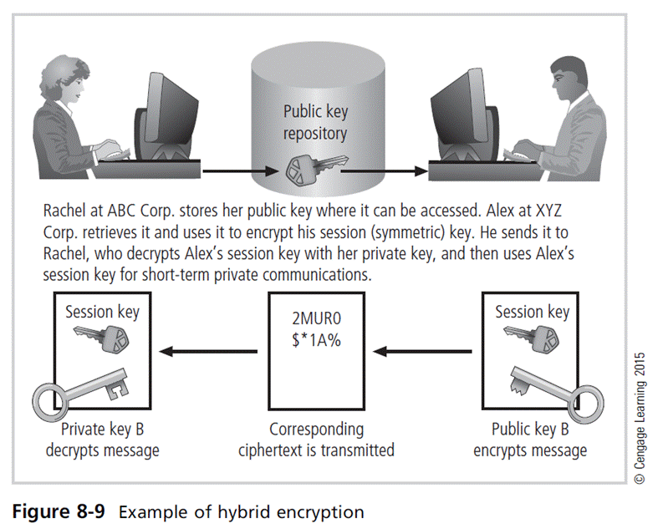
Principles of Information Security, Fifth Edition

Slide 33
Steganography
“Art of secret writing”
Has been used for centuries
Most popular modern version hides information within files that contain digital pictures or other images
Some applications hide messages in .bmp, .wav, .mp3, and .au files, as well as in unused space on CDs and DVDs
Principles of Information Security, Fifth Edition
Notes:
Steganography
“Art of secret writing”
Has been used for centuries
Most popular modern version hides information within files that contain digital pictures or other images
Some applications hide messages in .bmp, .wav, .mp3, and .au files, as well as in unused space on CDs and DVDs

Slide 34
Protocols for Secure Communications
Most of the software currently used to protect the confidentiality of information are not true cryptosystems.
They are applications to which cryptographic protocols have been added.
Particularly true of Internet protocols
As the number of threats to the Internet grew, so did the need for additional security measures.
Principles of Information Security, Fifth Edition
Notes:
Protocols for Secure Communications
Most of the software currently used to protect the confidentiality of information are not true cryptosystems
They are applications to which cryptographic protocols have been added
Particularly true of Internet protocols
As the number of threats to the Internet grew, so did the need for additional security measures

Slide 35
Securing Internet Communication with S-HTTP and SSL
Secure Sockets Layer (SSL) protocol: uses public key encryption to secure channel over public Internet
Secure Hypertext Transfer Protocol (S-HTTP): extended version of Hypertext Transfer Protocol; provides for encryption of individual messages between client and server across Internet
S-HTTP is the application of SSL over HTTP.
  Allows encryption of information passing between computers through protected and secure virtual connection
Principles of Information Security, Fifth Edition
Notes:
Securing Internet Communication with S-HTTP and SSL
Secure Sockets Layer (SSL) protocol: uses public key encryption to secure channel over public Internet
Secure Hypertext Transfer Protocol (S-HTTP): extended version of Hypertext Transfer Protocol; provides for encryption of individual messages between client and server across Internet
S-HTTP is the application of SSL over HTTP
Allows encryption of information passing between computers through protected and secure virtual connection

Slide 36
Securing E-mail with S/MIME, PEM, and PGP
Secure Multipurpose Internet Mail Extensions (S/MIME): builds on Multipurpose Internet Mail Extensions (MIME) encoding format and uses digital signatures based on public-key cryptosystems
Privacy Enhanced Mail (PEM): proposed as standard to use 3DES symmetric key encryption and RSA for key exchanges and digital signatures
Pretty Good Privacy (PGP): uses IDEA Cipher for message encoding
Principles of Information Security, Fifth Edition
Notes:
Securing E-mail
A number of encryption cryptosystems have been adapted in an attempt to inject some degree of security into e-mail, a notoriously unsecured medium.
S/MIME builds on the Multipurpose Internet Mail Extensions (MIME) encoding format by adding encryption and authentication through digital signatures based on public key cryptosystems.
Privacy Enhanced Mail (PEM) was proposed by the Internet Engineering Task Force (IETF) as a standard to function with the public-key cryptosystems.
PEM uses 3DES symmetric key encryption and RSA for key exchanges and digital signatures.
Pretty Good Privacy (PGP) was developed by Phil Zimmerman and uses the IDEA Cipher, a 128-bit symmetric key block encryption algorithm with 64-bit blocks for message encoding.
IDEA performs eight rounds on 16-bit sub-blocks using algebraic calculations.
PGP also uses RSA for symmetric key exchange and for digital signatures.
Secure Multipurpose Internet Mail Extensions (S/MIME): builds on Multipurpose Internet Mail Extensions (MIME) encoding format and uses digital signatures based on public-key cryptosystems
Privacy Enhanced Mail (PEM): proposed as standard to use 3DES symmetric key encryption and RSA for key exchanges and digital signatures
Pretty Good Privacy (PGP): uses IDEA Cipher for message encoding

Slide 37
Securing Web Transactions with SET, SSL, and S-HTTP
Secure Electronic Transactions (SET): developed by MasterCard and VISA in 1997 to protect against electronic payment fraud
Uses DES to encrypt credit card information transfers
Provides security for both Internet-based credit card transactions and credit card swipe systems in retail stores
Principles of Information Security, Fifth Edition
Notes:
Securing Web Transactions with SET, SSL, and S-HTTP
Secure Electronic Transactions (SET): developed by MasterCard and VISA in 1997 to protect against electronic payment fraud
Uses DES to encrypt credit card information transfers
Provides security for both Internet-based credit card transactions and credit card swipe systems in retail stores

Slide 38
Securing Wireless Networks with WEP and WPA
Wired Equivalent Privacy (WEP): early attempt to provide security with the 8002.11 network protocol
Wi-Fi Protected Access (WPA and WPA2): created to resolve issues with WEP
Next Generation Wireless Protocols: Robust Secure Networks (RSN), AES–Counter Mode CBC MAC Protocol (CCMP)
Bluetooth: can be exploited by anyone within approximately 30 foot range, unless suitable security controls are implemented
Principles of Information Security, Fifth Edition

Slide 39
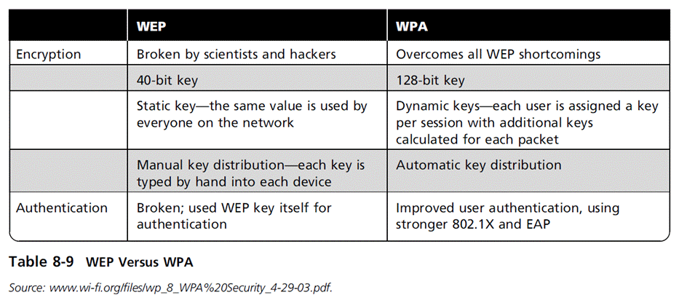
Principles of Information Security, Fifth Edition

Slide 40
Securing TCP/IP with IPSec and PGP
Internet Protocol Security (IPSec): an open-source protocol framework for security development within the TCP/IP family of protocol standards
IPSec uses several different cryptosystems.
  Diffie-Hellman key exchange for deriving key material between peers on a public network
  Public key cryptography for signing the Diffie-Hellman exchanges to guarantee identity
  Bulk encryption algorithms for encrypting the data
  Digital certificates signed by a certificate authority to act as digital ID cards
Principles of Information Security, Fifth Edition

Slide 41
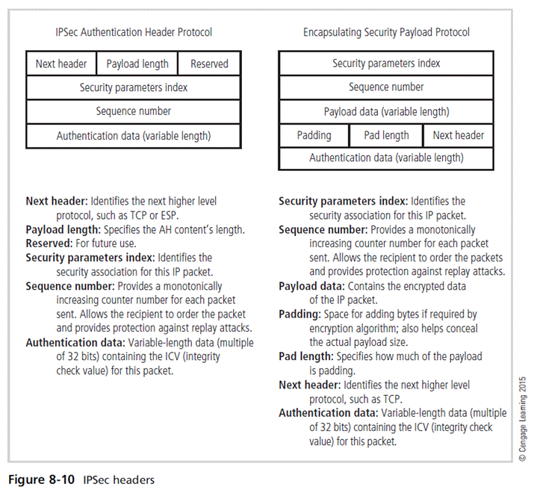
Principles of Information Security, Fifth Edition

Slide 42
Securing TCP/IP with IPSec and PGP (cont’d)
Pretty Good Privacy (PGP): hybrid cryptosystem designed in 1991 by Phil Zimmermann
  Combined best available cryptographic algorithms to become open source de facto standard for encryption and authentication of e-mail and file storage applications.
  Freeware and low-cost commercial PGP versions are available for many platforms.
  PGP security solution provides six services: authentication by digital signatures, message encryption, compression, e-mail compatibility, segmentation, key management
Principles of Information Security, Fifth Edition
Notes:
PGP
Pretty Good Privacy (PGP): hybrid cryptosystem designed in 1991 by Phil Zimmermann
Combined best available cryptographic algorithms to become open source de facto standard for encryption and authentication of e-mail and file storage applications
Freeware and low-cost commercial PGP versions are available for many platforms
PGP security solution provides six services: authentication by digital signatures; message encryption; compression; e-mail compatibility; segmentation; key management

Slide 43
Summary
Cryptography and encryption provide sophisticated approach to security.
  Many security-related tools use embedded encryption technologies.
  Encryption converts a message into a form that is unreadable by the unauthorized.
Many tools are available and can be classified as symmetric or asymmetric, each having advantages and special capabilities.
Principles of Information Security, Fifth Edition

Slide 44
Summary (cont’d)
Strength of encryption tool is dependent on the key size but even more dependent on following good management practices.
Cryptography is used to secure most aspects of Internet and Web uses that require it, drawing on extensive set of protocols and tools designed for that purpose.
Principles of Information Security, Fifth Edition

